Slide 1
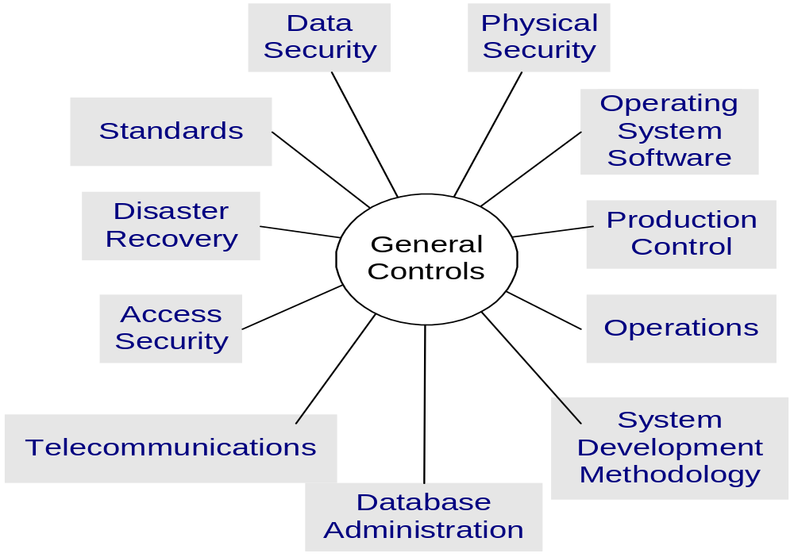
General Controls Summary
Not in your book

Slide 2
Information Security Strategy
Security Management Cycle
Define
Environment
& Assets
Monitoring
&
Audits
Security
Risk
Analysis
Security
Administration
Policies,
Standards,
& Guidelines
Security
Design
Implementation

